Slide 1
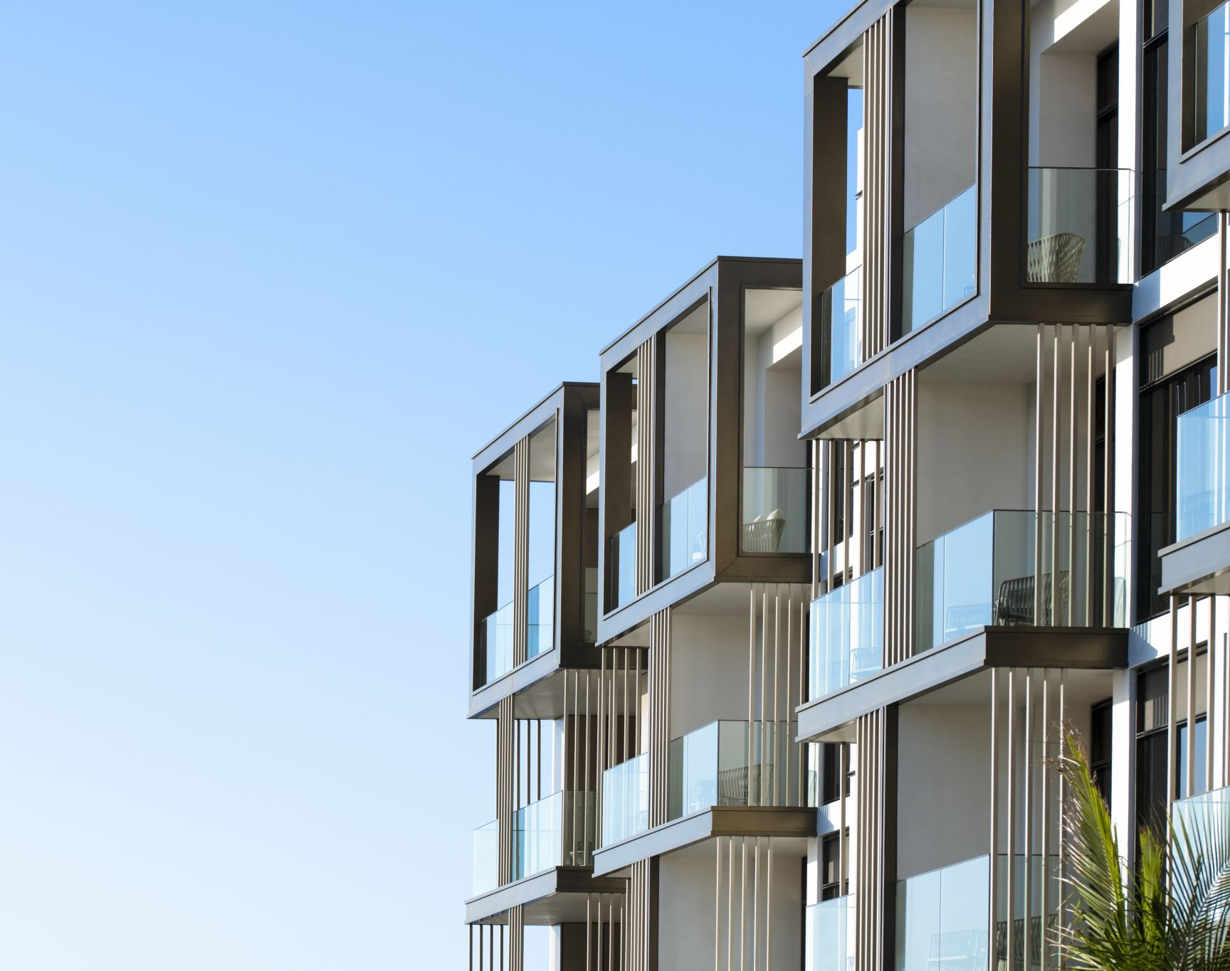
Real Estate Poland
Apartaments for the Masovian Voivodeship
November, 2022 Analysis by: Agnieszka Wojno

Slide 2
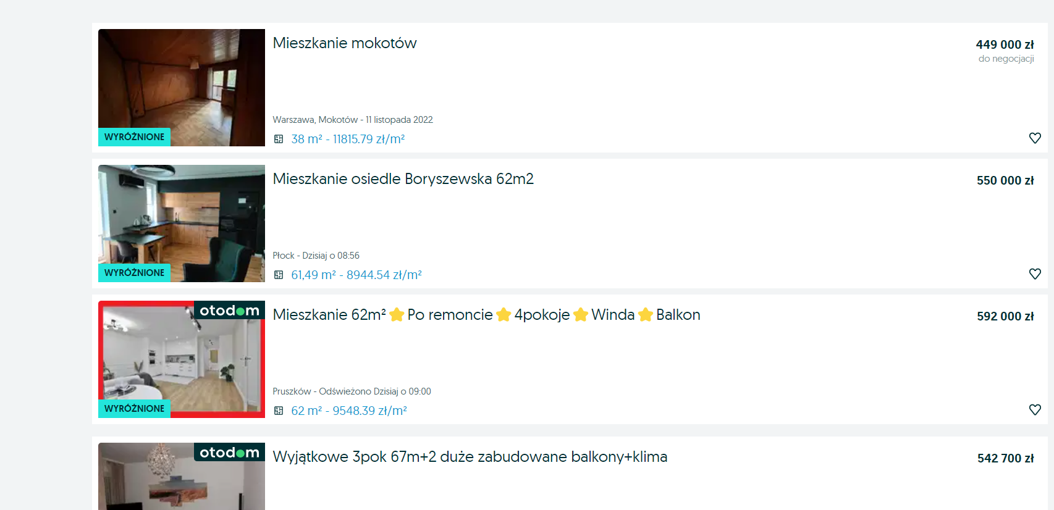
Source of the data: the data was scraped from OLX platform
https://www.olx.pl/d/nieruchomosci/mieszkania/sprzedaz/mazowieckie/
Masovian Voivodeship/Poland

Slide 3
Flats - number of rooms
Numer of rooms | Amount of listed apartaments
1 | 761
2 | 2006
3 | 3251
4 | 1077

Slide 4
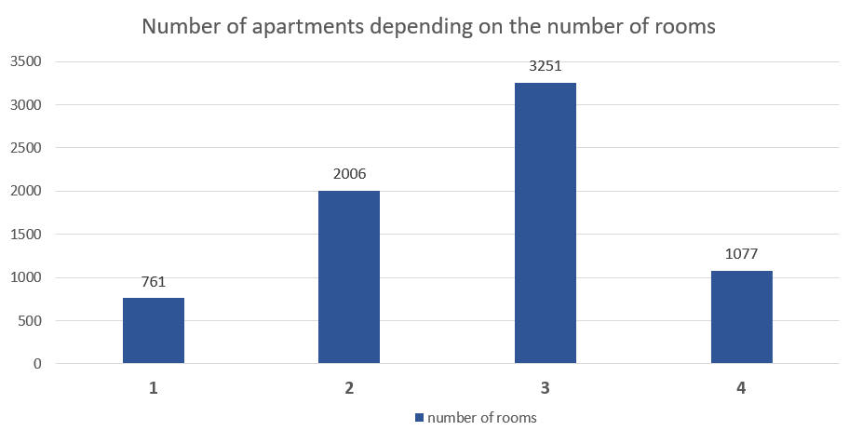
Chart of the number of apartments depending on the number of rooms
Most are three-room apartments

Slide 5
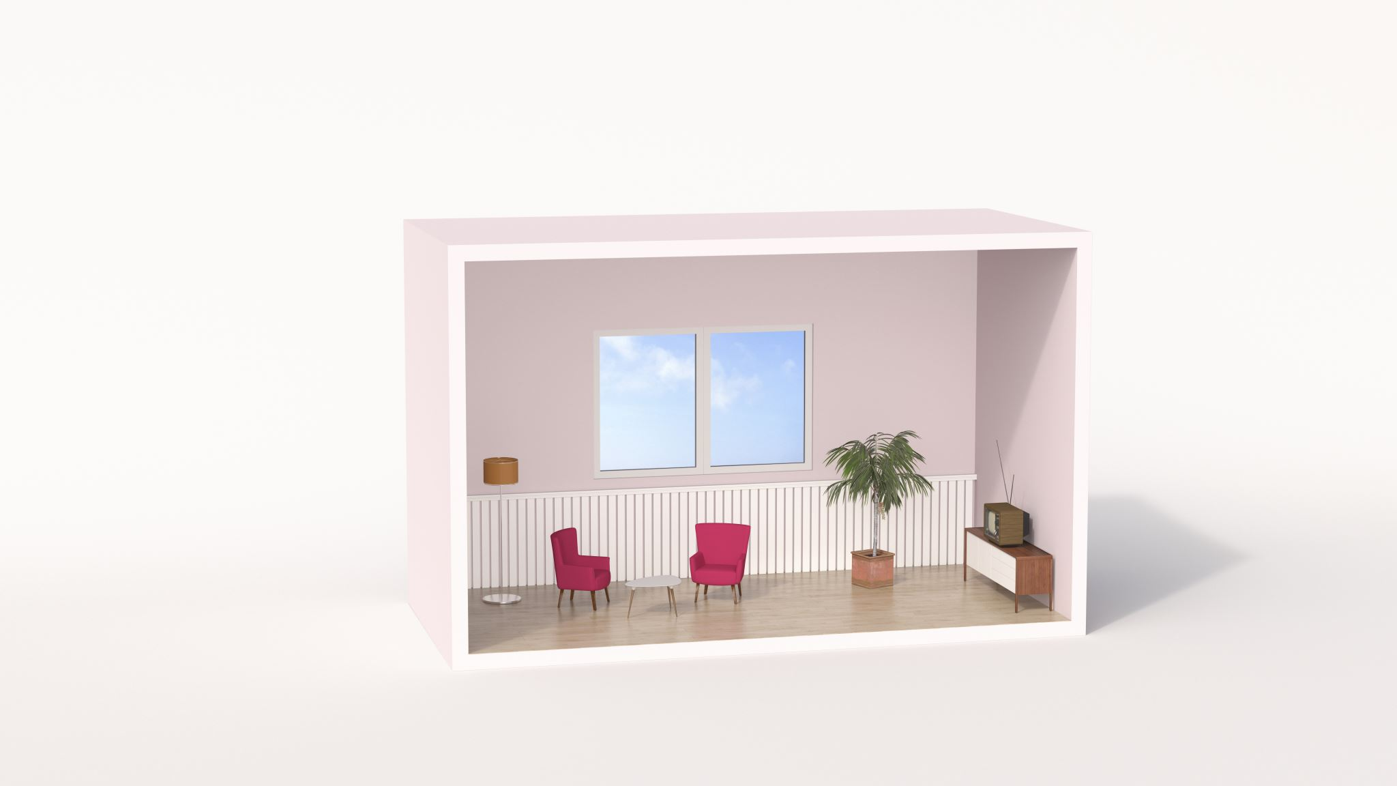
One room apartaments

Slide 6
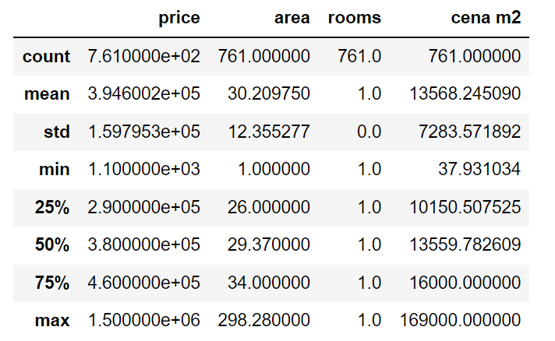
One room describe
price for square meter

Slide 7
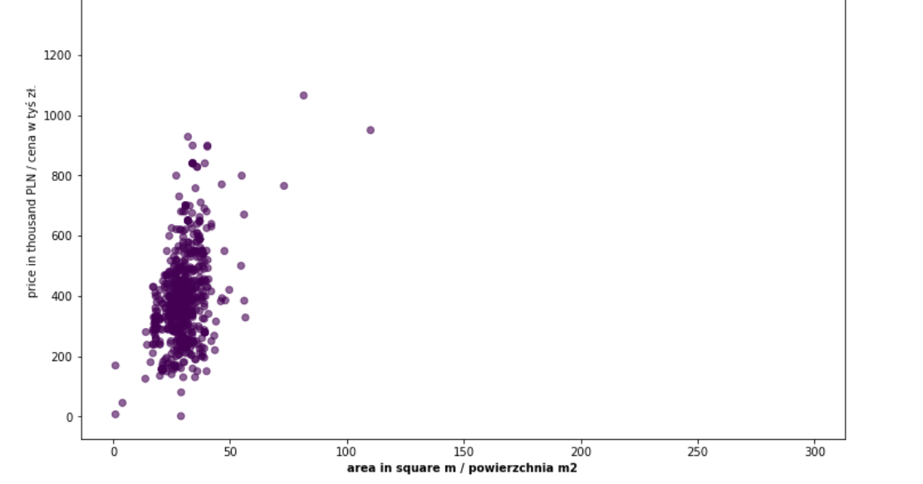

Slide 8
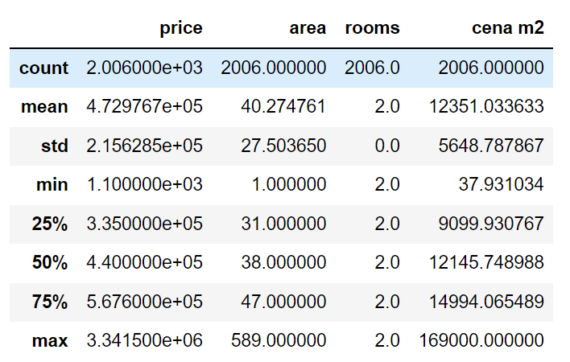
Two rooms describe
price for square meter

Slide 9
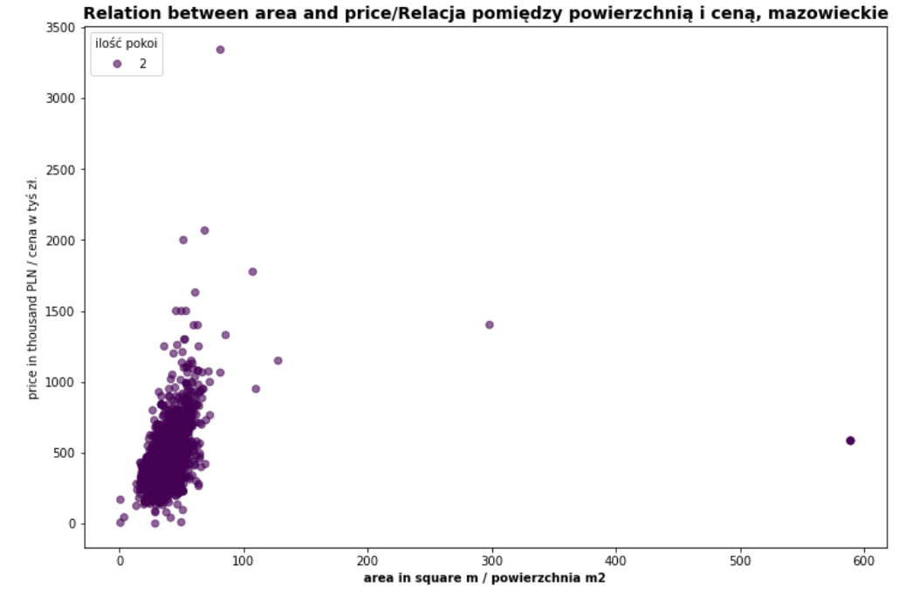
Relation between area and price (2 rooms)

Slide 10
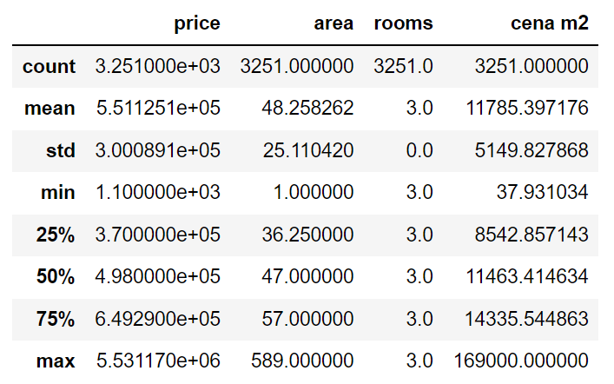
Three rooms describe
price for square meter

Slide 11
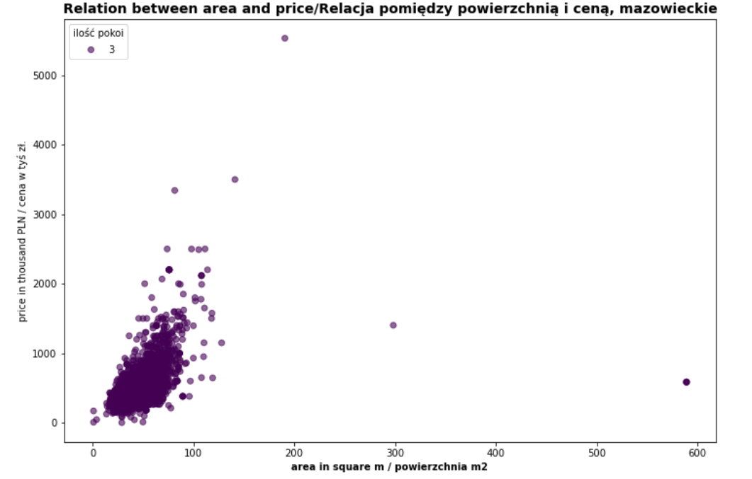
Relation between area and price (3 rooms)

Slide 12

For rooms apartaments (or more)

Slide 13
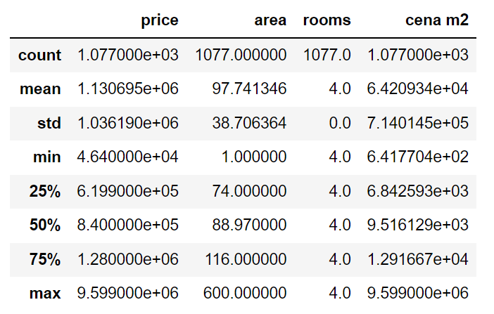
Four+ rooms describe
price for square meter

Slide 14
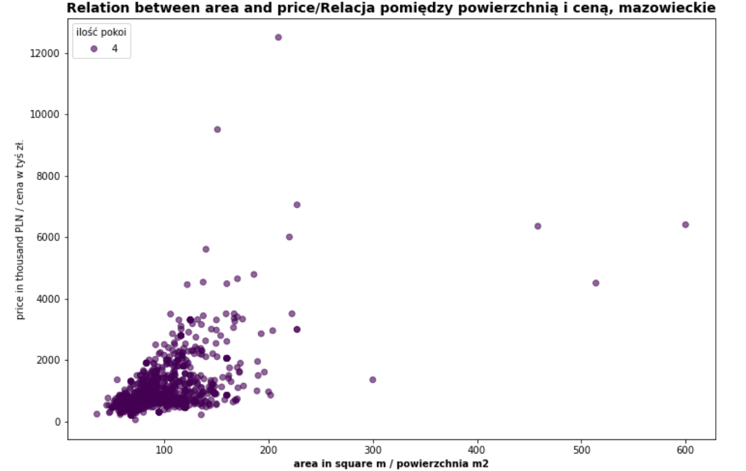
Relation between area and price (4 rooms)

Slide 15
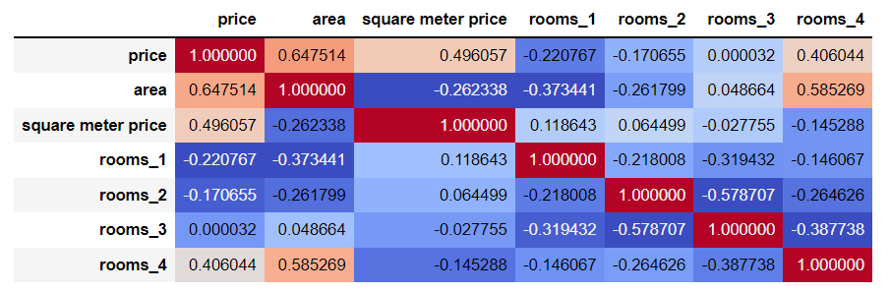
There is quite strong correlation between (price and area) and (area and rooms_4)

Slide 16
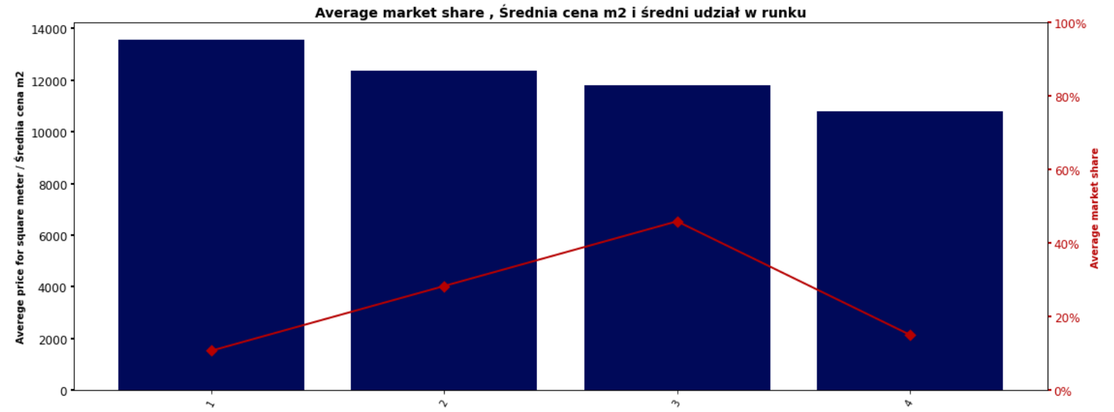
Average price for square meter and average market share
We can observe that prices increase in 3-room apartments and decrease in 4-room apartments.​ 3-room apartments have the highest average market share.

Slide 17
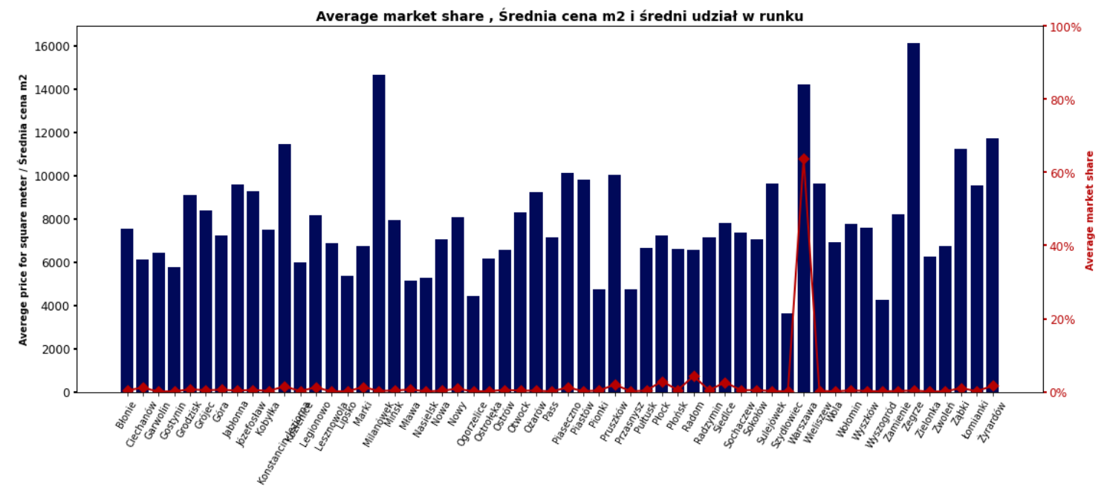
Average price for the city and average market share
We can observe that Warsow has the highest average market share.

Slide 18
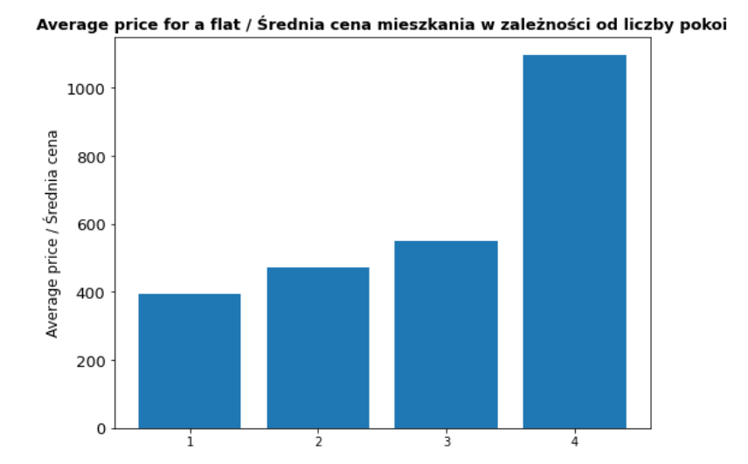
Average price per apartment depending on the number of rooms
We can observe that the highest average price have 4-room apartments (or more) .

Slide 19
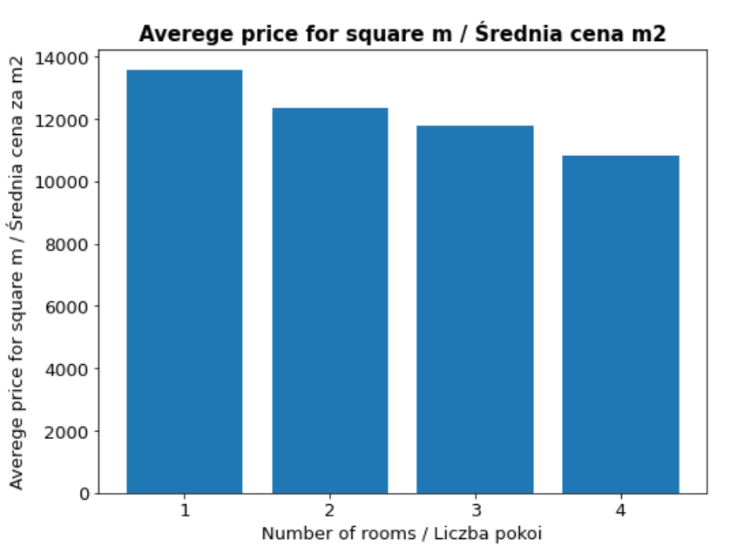
Average price of square meter depending on number of rooms
We can observe that the highest prices per square meter have 1-room apartments. The lowest is for 4 rooms (or more)

Slide 20
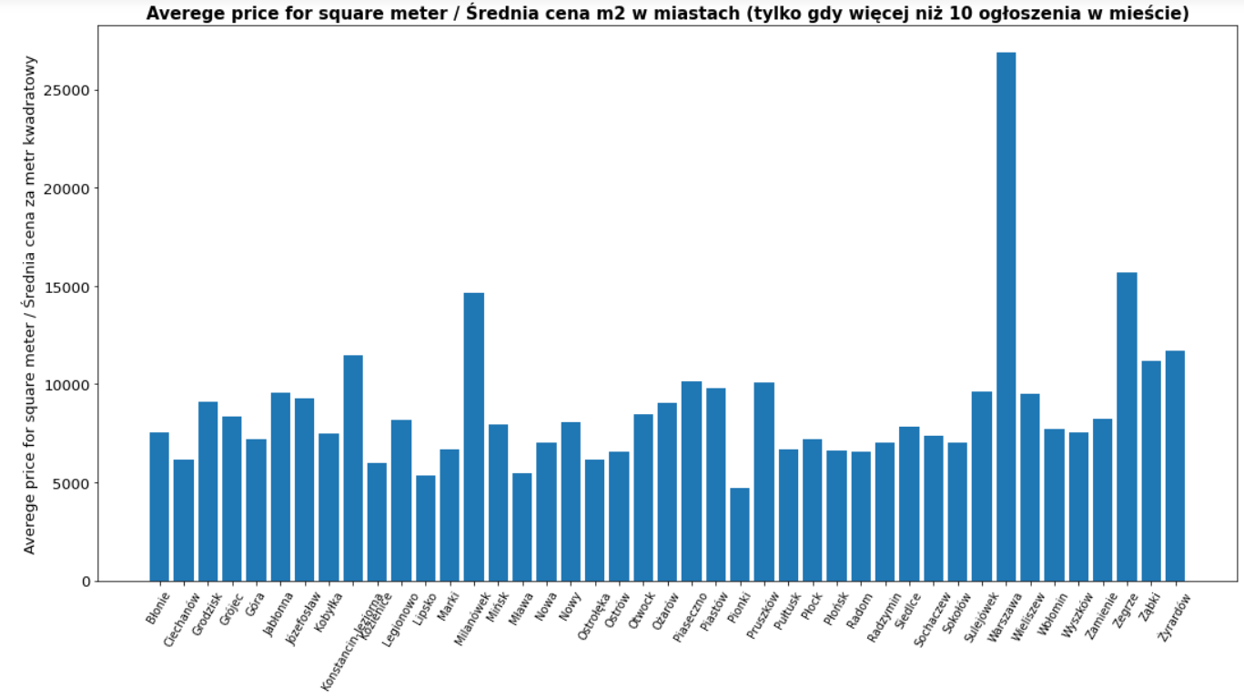
Average price of square meter per city
We can observe that the highest price of square meter is for Warsow . It's over 25K PLN.

Slide 21
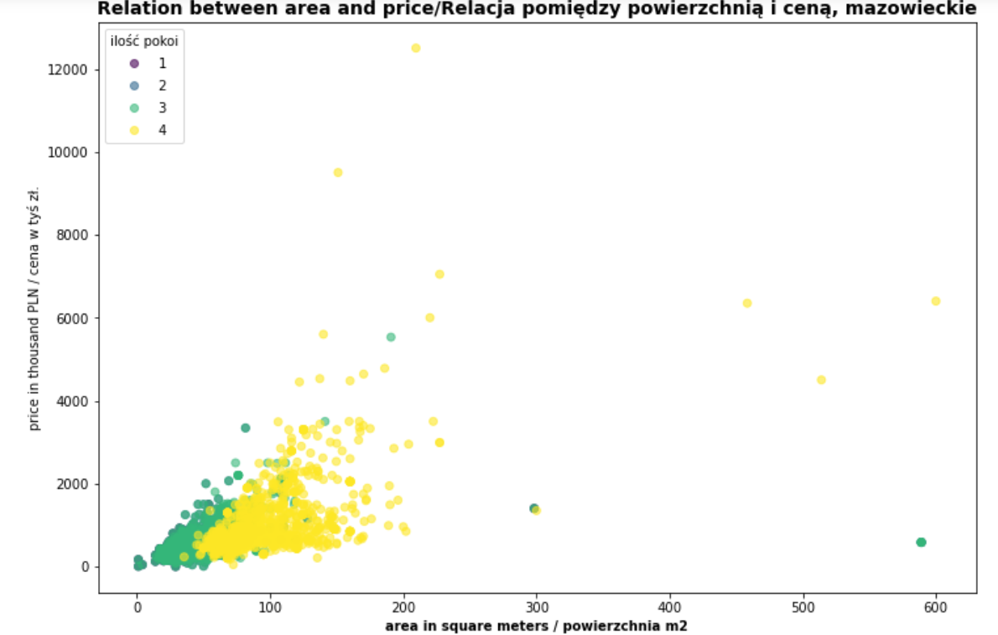
Relation between area and price
number of rooms

Slide 22
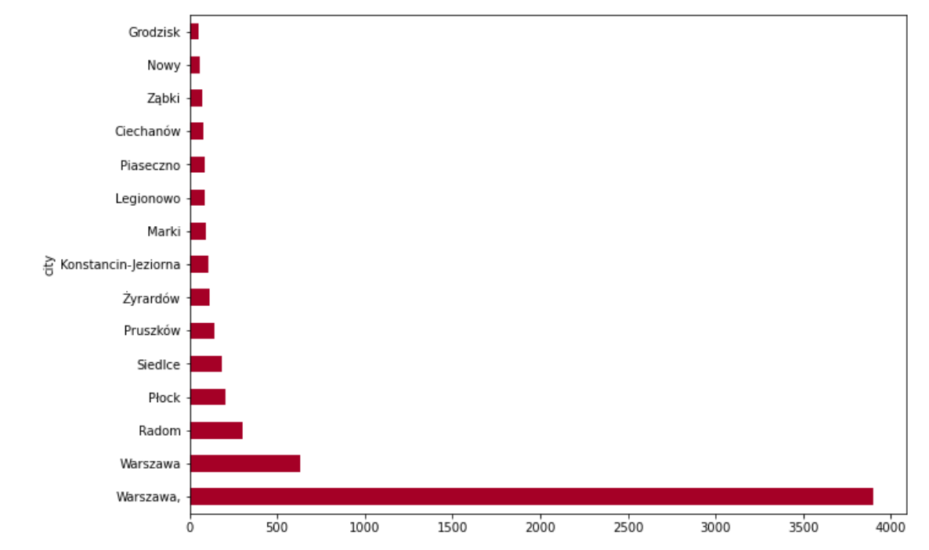
Amount of listed apartaments per city
We can observe that the highest amount of listed flats has Warsow city. It's almost 4K.

Slide 23

Global price for squared meter
11 989,15 PLN

Slide 24
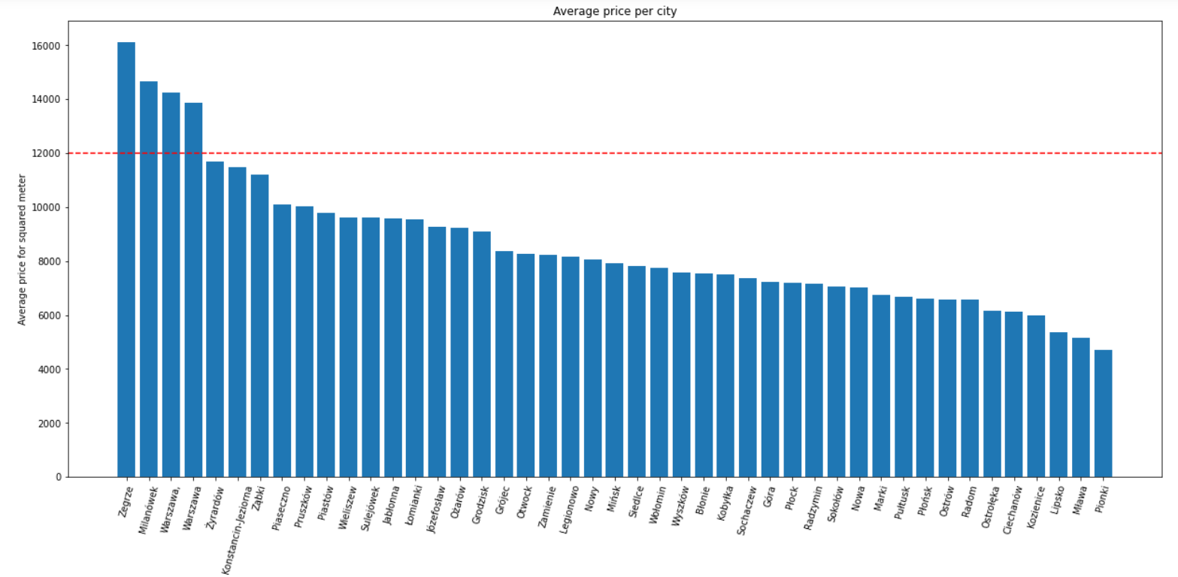
Average price for the city

Slide 25
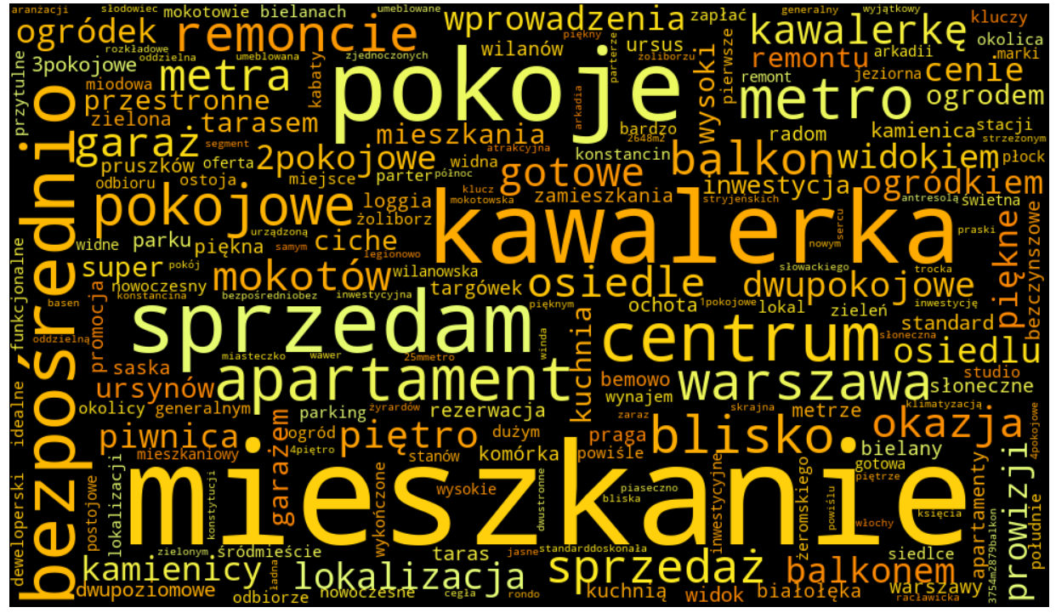
The Word Cloud

